Slide 1
Point cloud upsampling
Zhao Weibing
2020/04/17

Slide 2
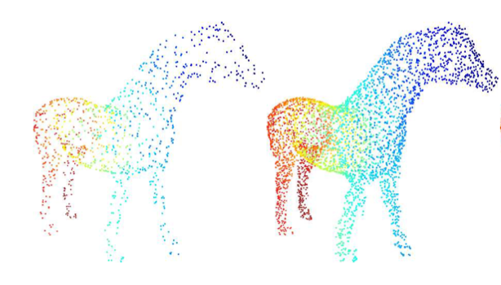
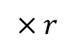
Upsampling problem
Given a set of points, generate a denser set of points to describe the underlying geometry by learning the geometry of a training dataset.
Input
Output
$$× r$$
(N, 3)
(rN, 3)
Notes:
和2D超分很像，也有不同：

Slide 3
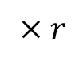
Upsampling problem
Input
Output
$$× r$$
(N, 3)
(rN, 3)
Difference with the image super-resolution problem:
Point cloud do not have any spatial order and regular structure.
The generated points should roughly lie on the target object surface.
The generated points should be informative and should not clutter together. (should be more uniform on the target object surface)
Notes:
和2D超分很像，也有不同：2. The generated points should describe the underlying geometry of a latent target object, meaning that they should roughly lie on the target object surface.
所以对input点云做interpolation不适用

Slide 4
Paper list
PU-Net: Point Cloud Upsampling Network. (2018 CVPR)
Patch-based Progressive 3D Point Set Upsampling. (2019 CVPR)
PU-GAN: a Point Cloud Upsampling Adversarial Network. (2019 ICCV)
PU-GCN: Point Cloud Upsampling via Graph Convolutional Network. (2019 arxiv)

Slide 5
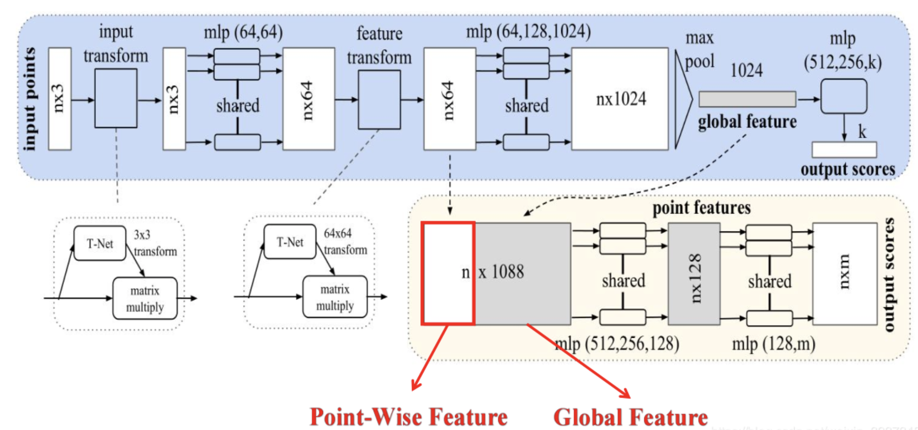
PointNet

Slide 6
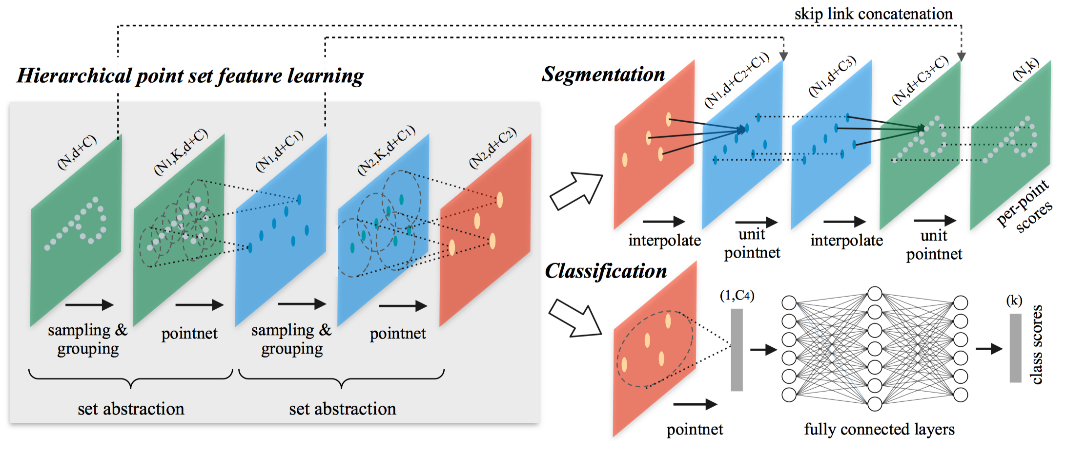
PointNet++

Slide 7
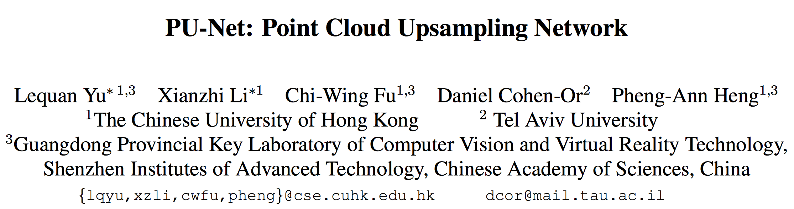

Slide 8
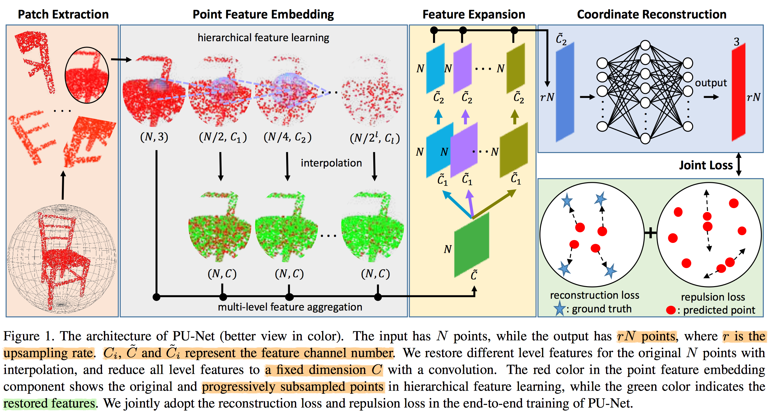

Slide 9
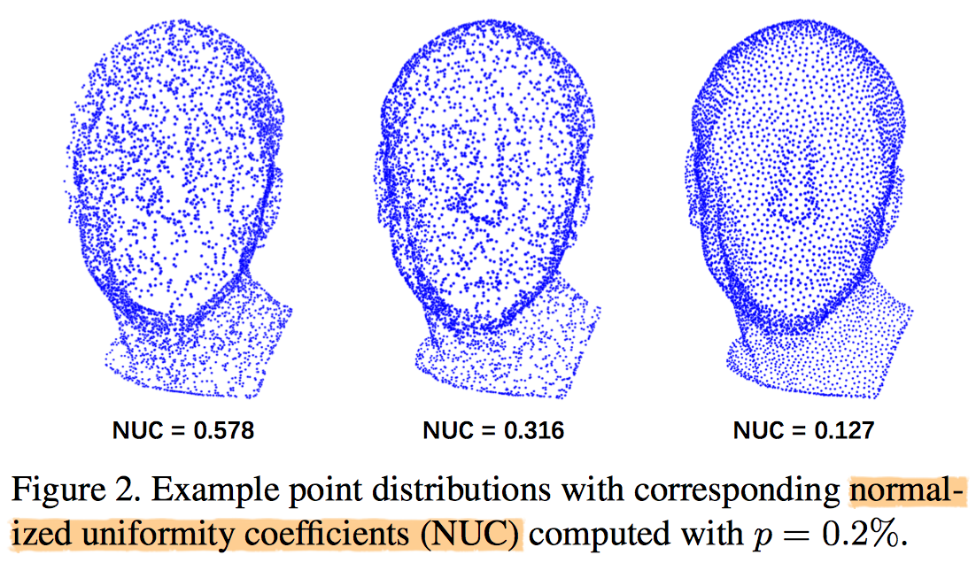
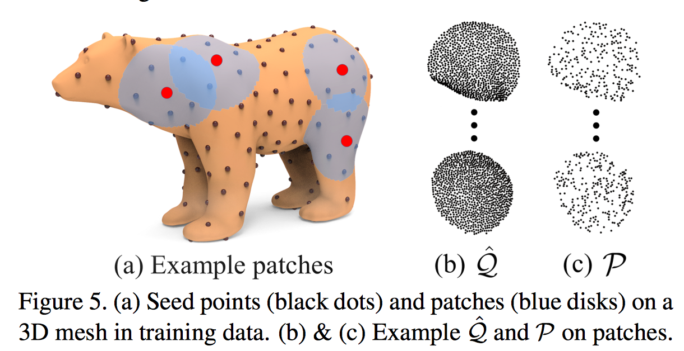
Evaluation metric:
Surface deviation: mean and standard deviation over all the points
Uniformity: Normalized uniformity coefficients (NUC) 密度的标准差
p: disk area / total surface area

Slide 10
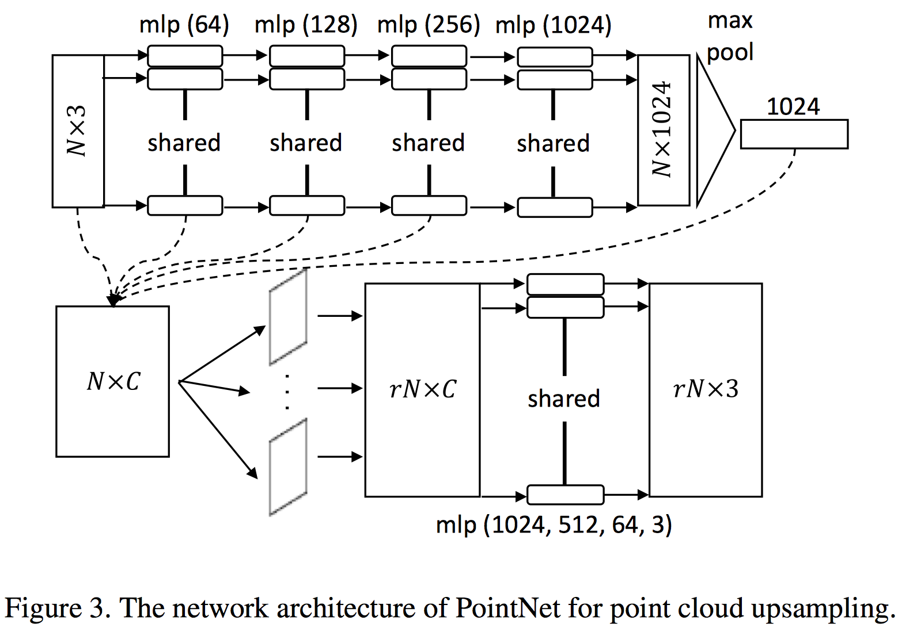

Slide 11
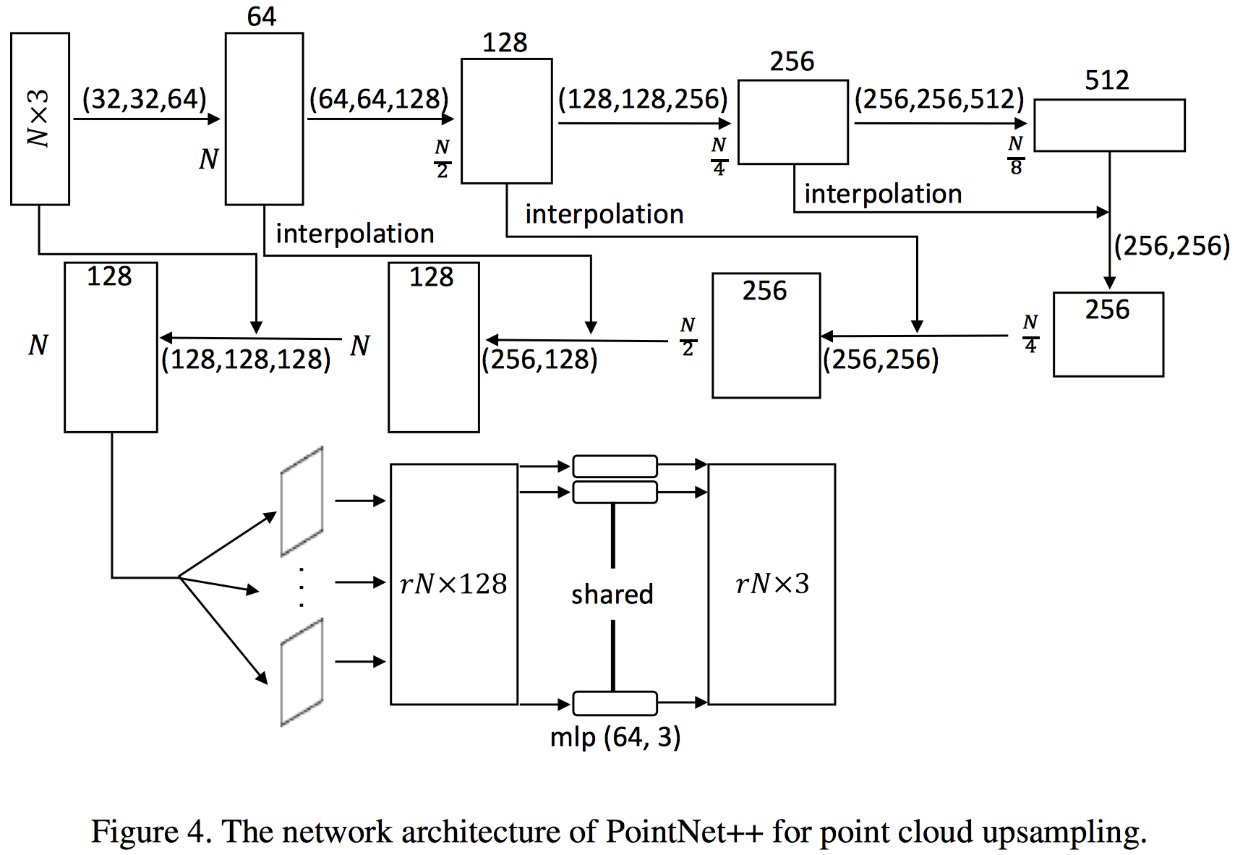

Slide 12
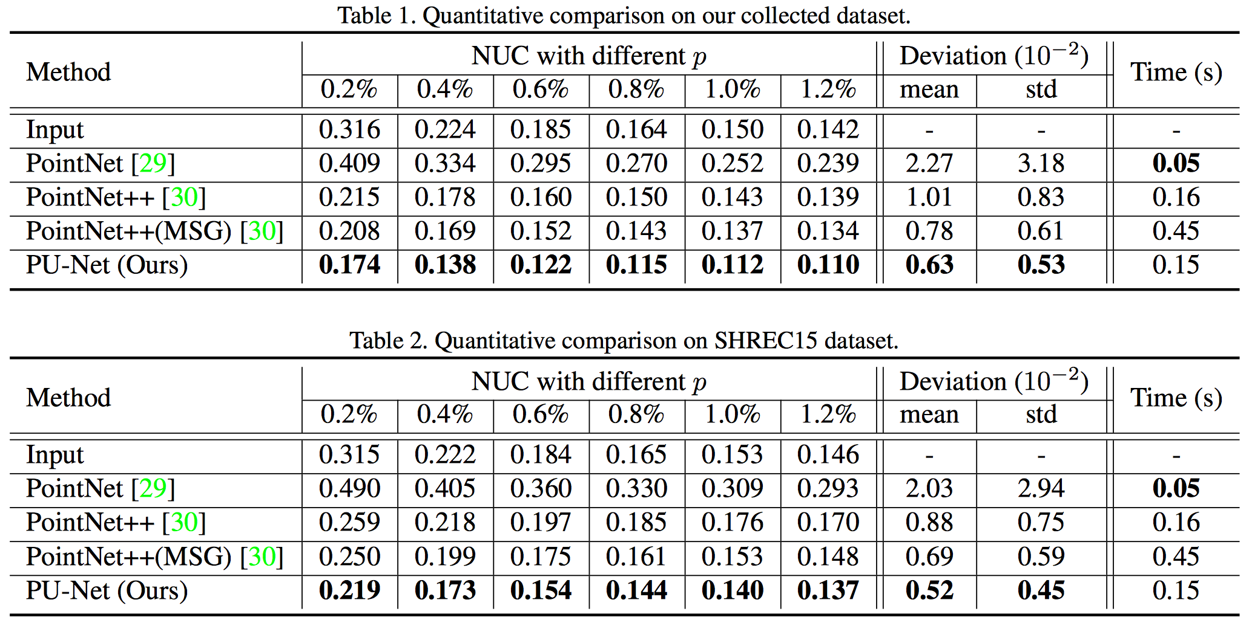
local uniformity
Global uniformity
Notes:
multi-scale grouping (MSG)

Slide 13
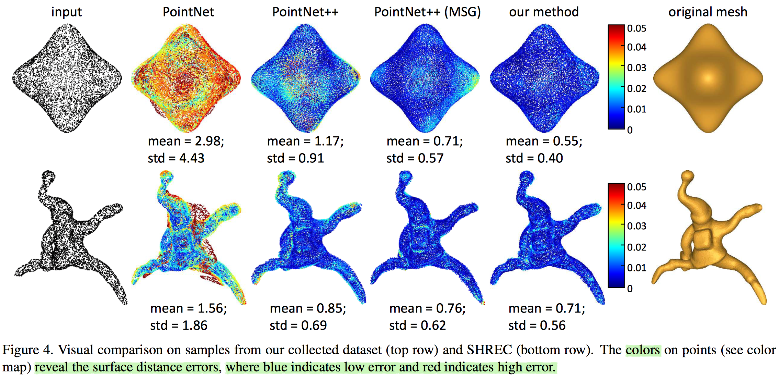

Slide 14
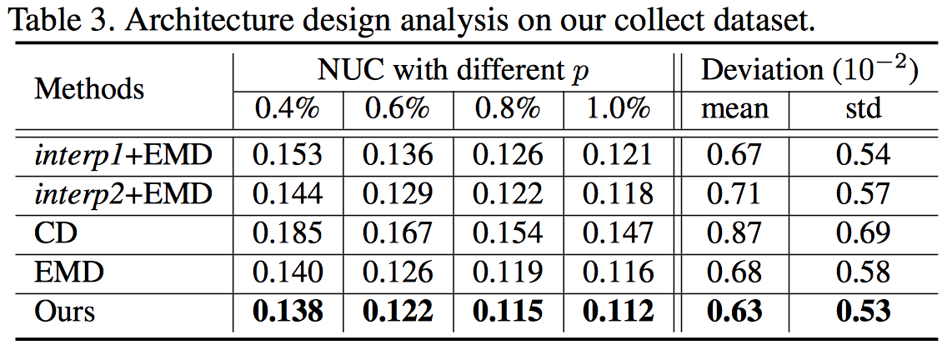
Analyzing the feature expansion & Comparing different loss functions

Slide 15
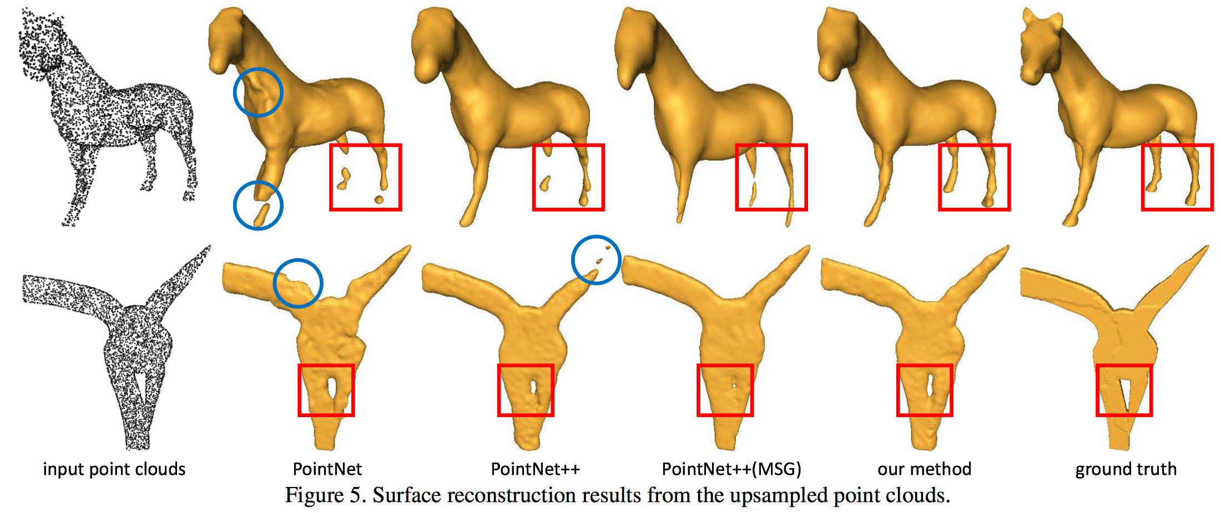
Application: Surface reconstruction from upsampled point sets
Notes:
An important application of point cloud upsampling is to improve the surface reconstruction quality.

Slide 16
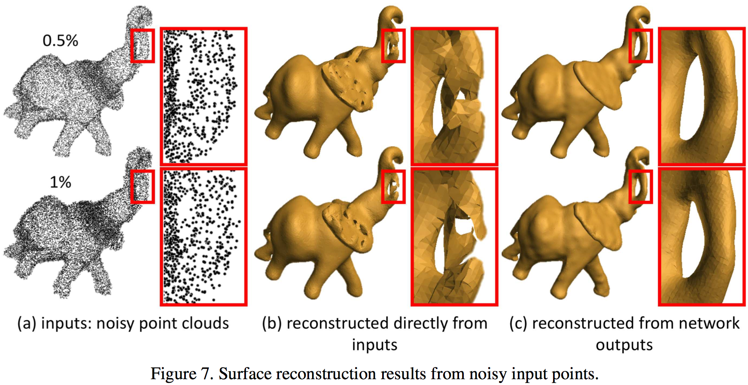
Results from noisy input point sets
Notes:
Results from noisy input point sets. Fig. 7 shows the surface reconstruction results from noisy point clouds (Gaussian noise of 0.5% and 1% of object bounding box diagonal), which demonstrate that our network facilitates the production of better surfaces even with noisy inputs.

Slide 17
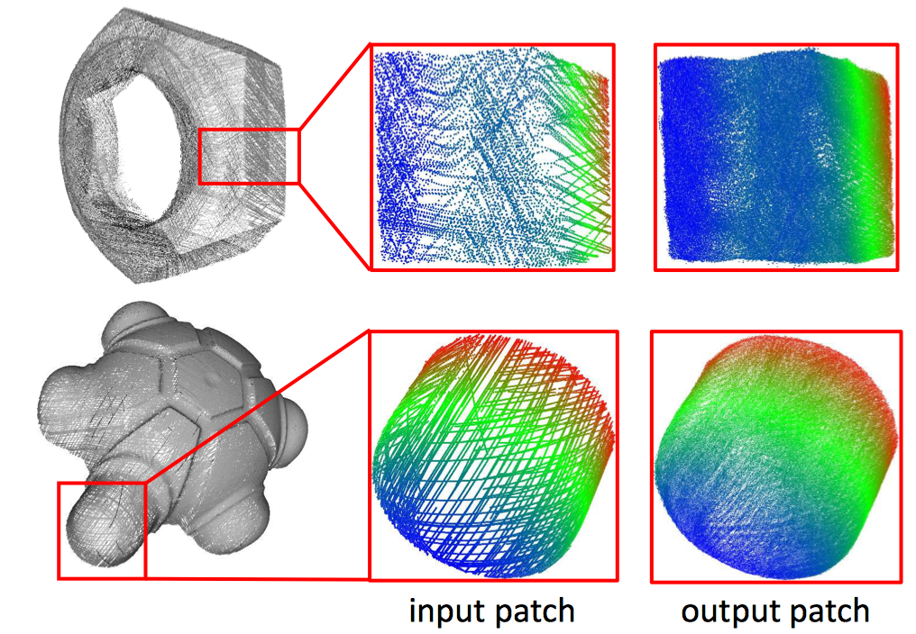
Results on real-scanned point clouds

Slide 18
Limitations:
PU-Net is not designed for completion, so it can not fill large holes and missing parts.
PU-Net may not be able to add meaningful points for tiny structures that are severely undersampled.

Slide 19
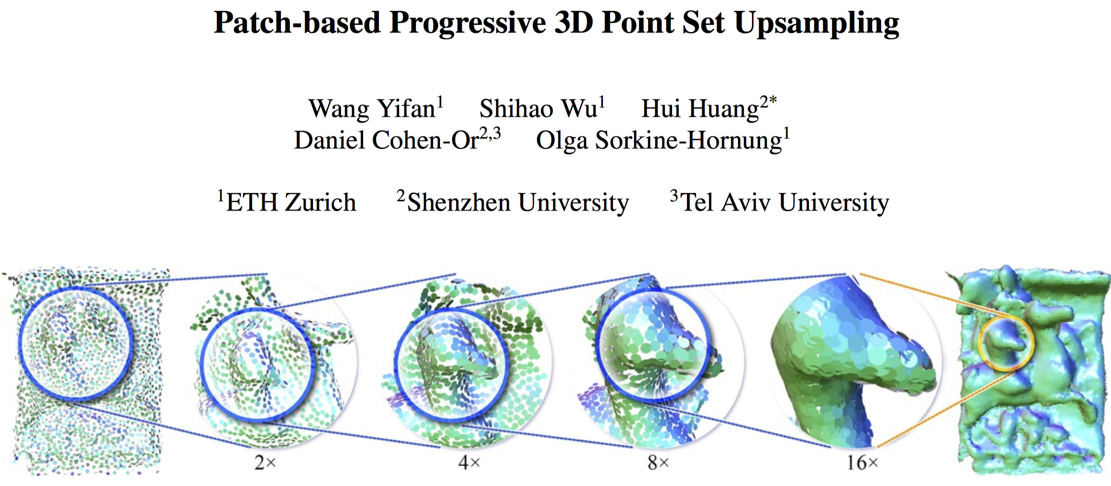

Slide 20
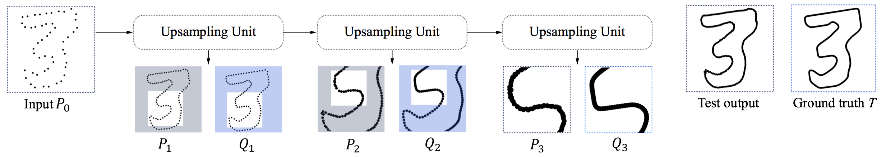
Disadvantage of PU-Net: The level of detail available in the input patch is fixed, and thus both high-level and low-level geometric structures are ignored.
This paper struggles with input points representing large-scale or fine-scale structures.
Multi-step upsampling: 16 x network → 2 x, 2x, 2x, 2x subnets
Each subnet focuses on a different level of detail.
The input patch size is adaptive with respect to the present level of detail.

Slide 21
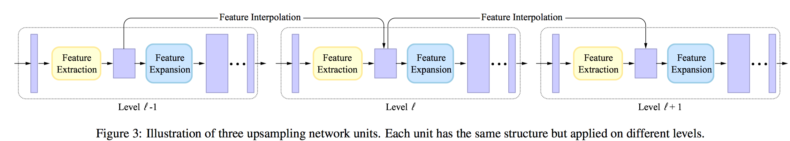
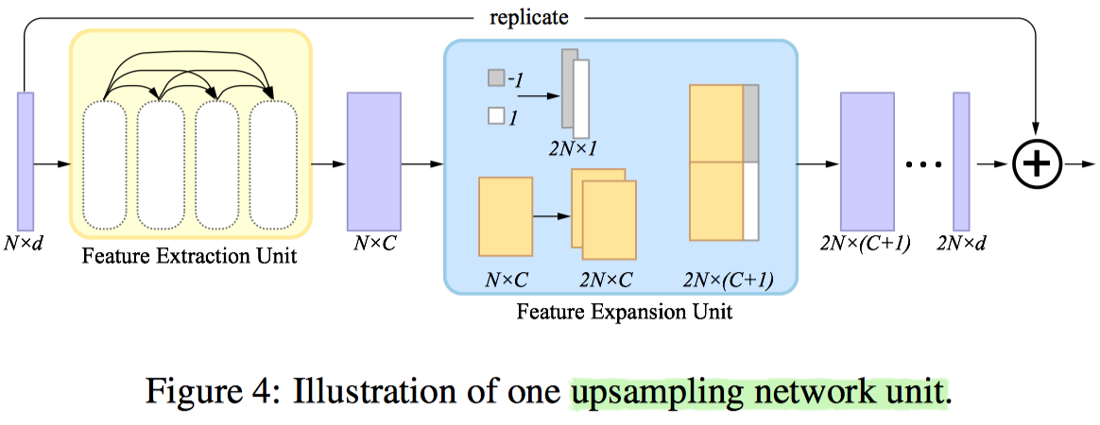
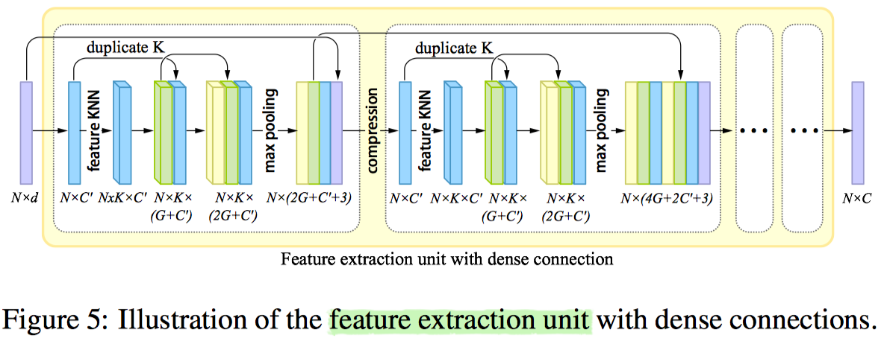
residual skip-connections
One upsampling network unit
Feature extraction unit
with dense connections
Notes:
[code assignment for efﬁcient feature expansion]: PU-Net replicates the per-point features and then processes each replicant independently by an individual set of MLPs. This approach may lead to clustered points around the original points positions, which is alleviated by introducing a repulsion loss. We assign a 1D code, with value −1 and 1, to each of those duplicated features to transform them to different locations. [bilateral feature interpolation for interlinks across the steps]: 由knn找到的k个邻居的特征加权得到，权重反比于（空间距离x特征距离）

Slide 22
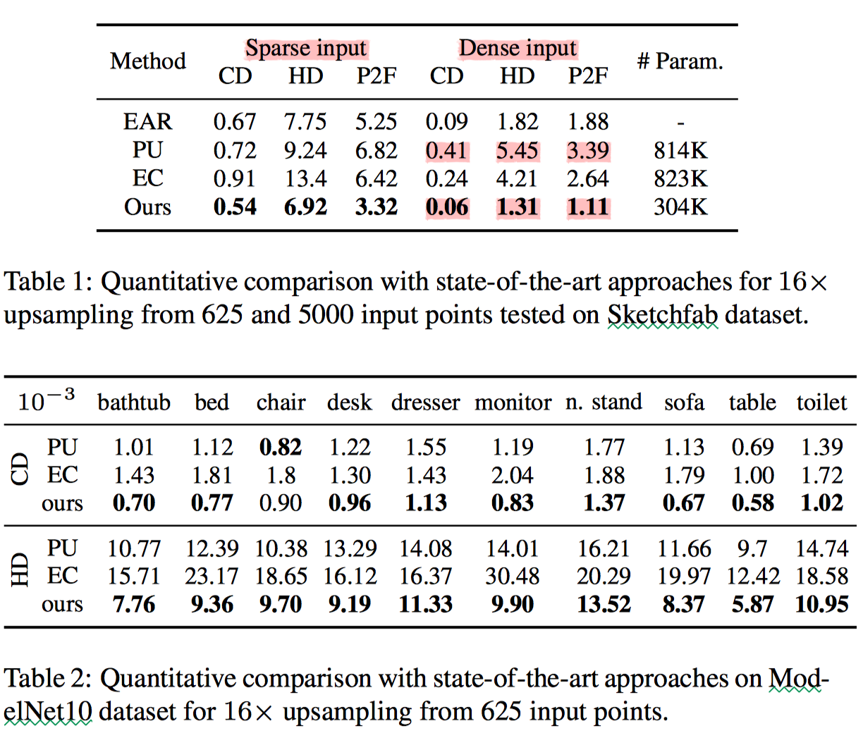
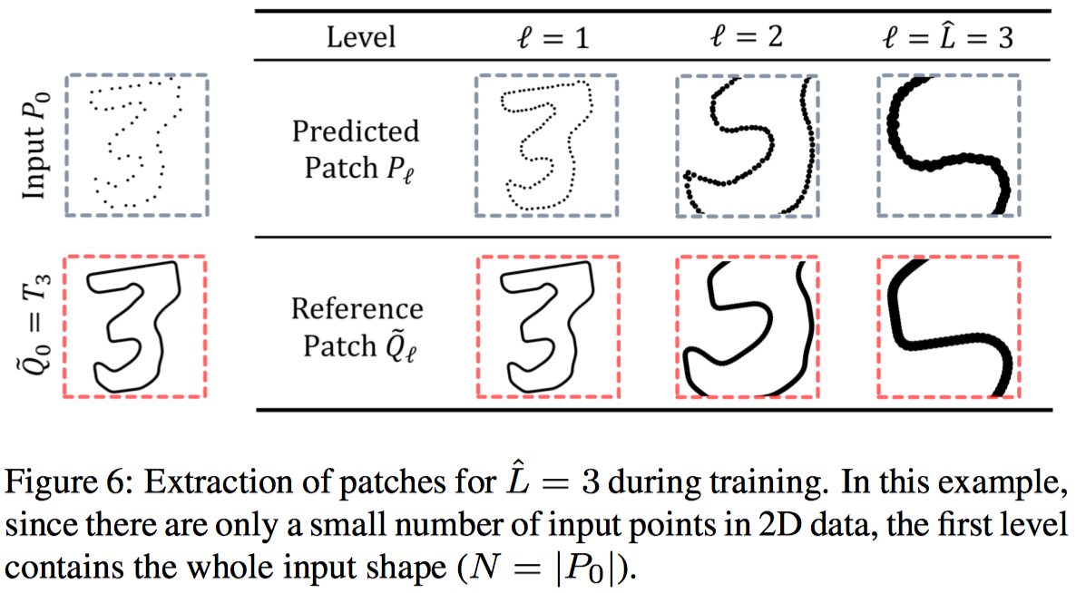
Notes:
the input to level l is obtained using kNN (k = N) around a random point p_{l-1} in P_{l-1}.
As shown in Table 1, the performance of PU-Net on sparse and dense inputs is similar, revealing its limitation for high levels of detail.

Slide 23
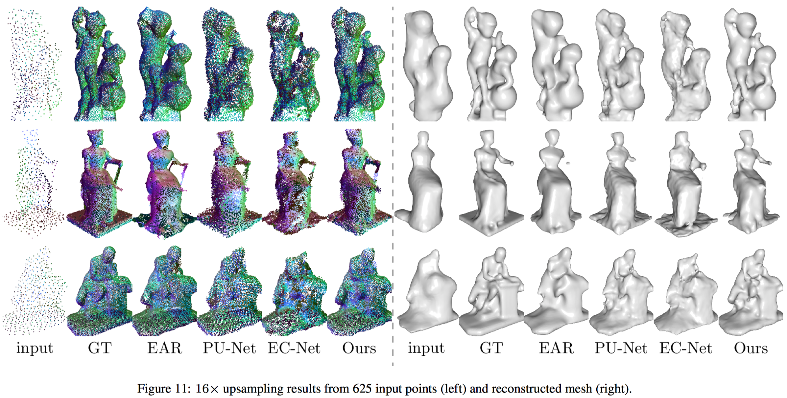

Slide 24
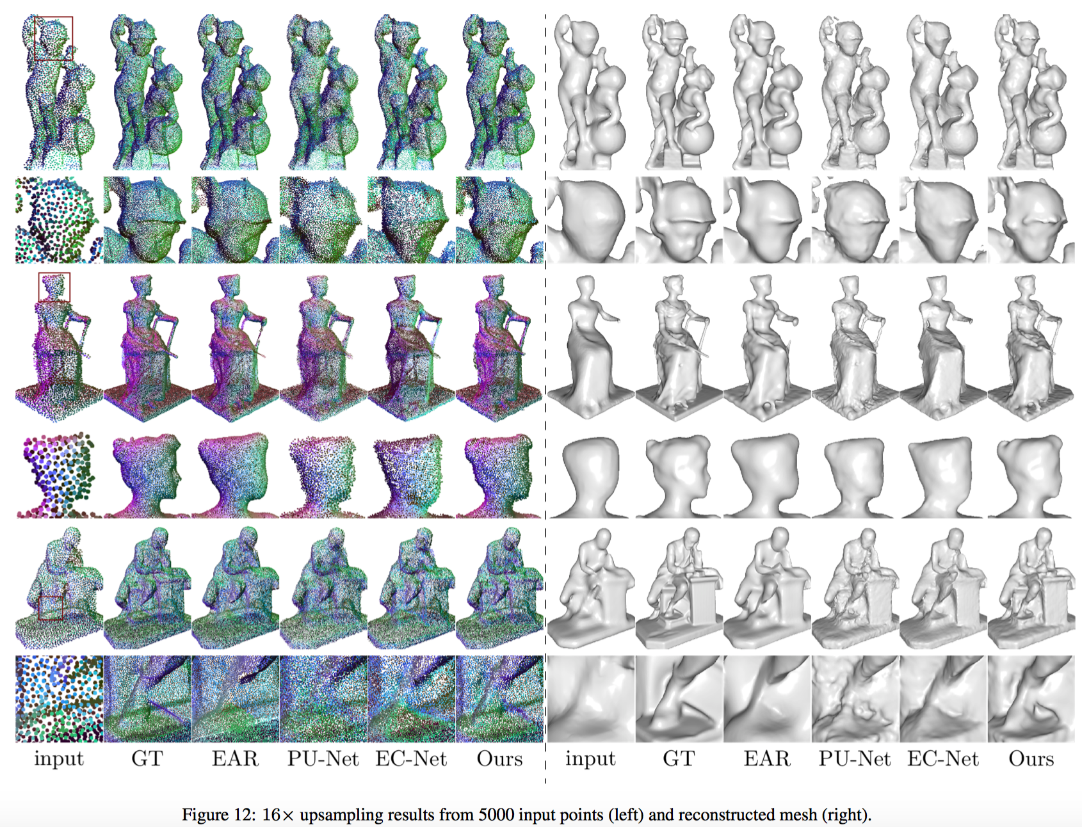
Notes:
restores ﬁne-grained geometric details

Slide 25
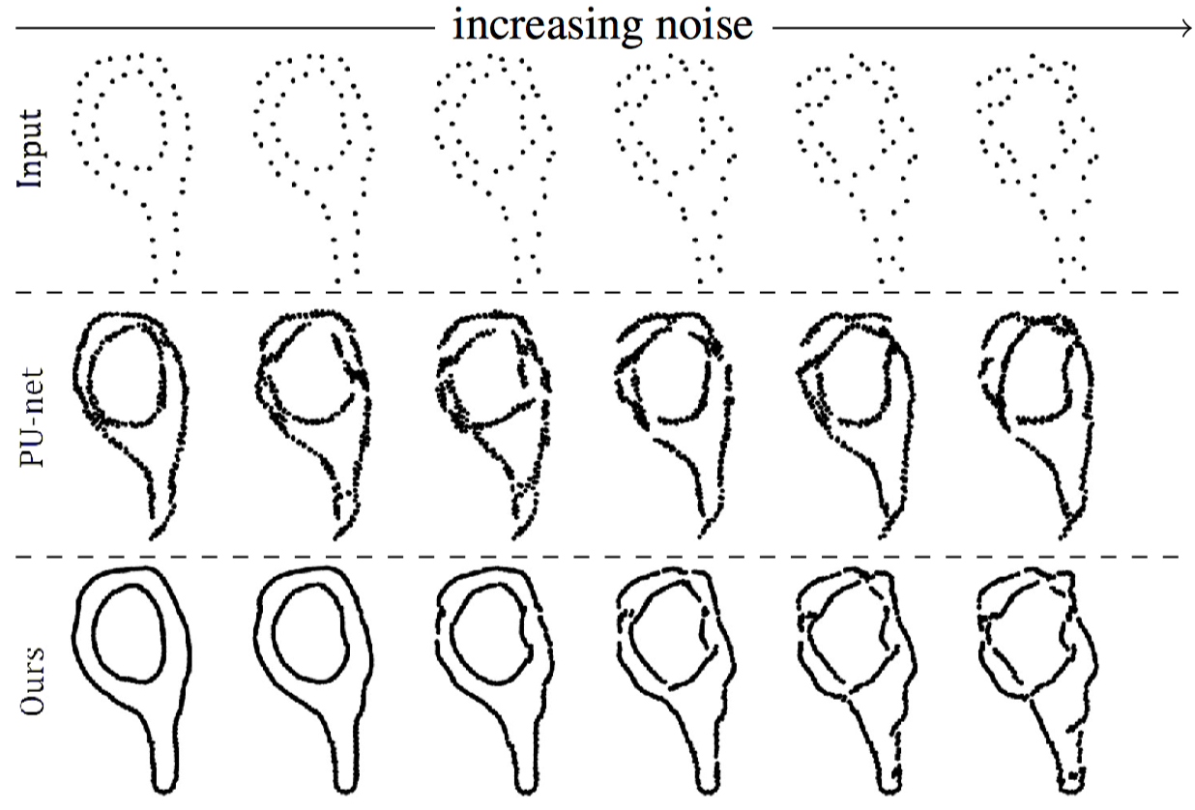
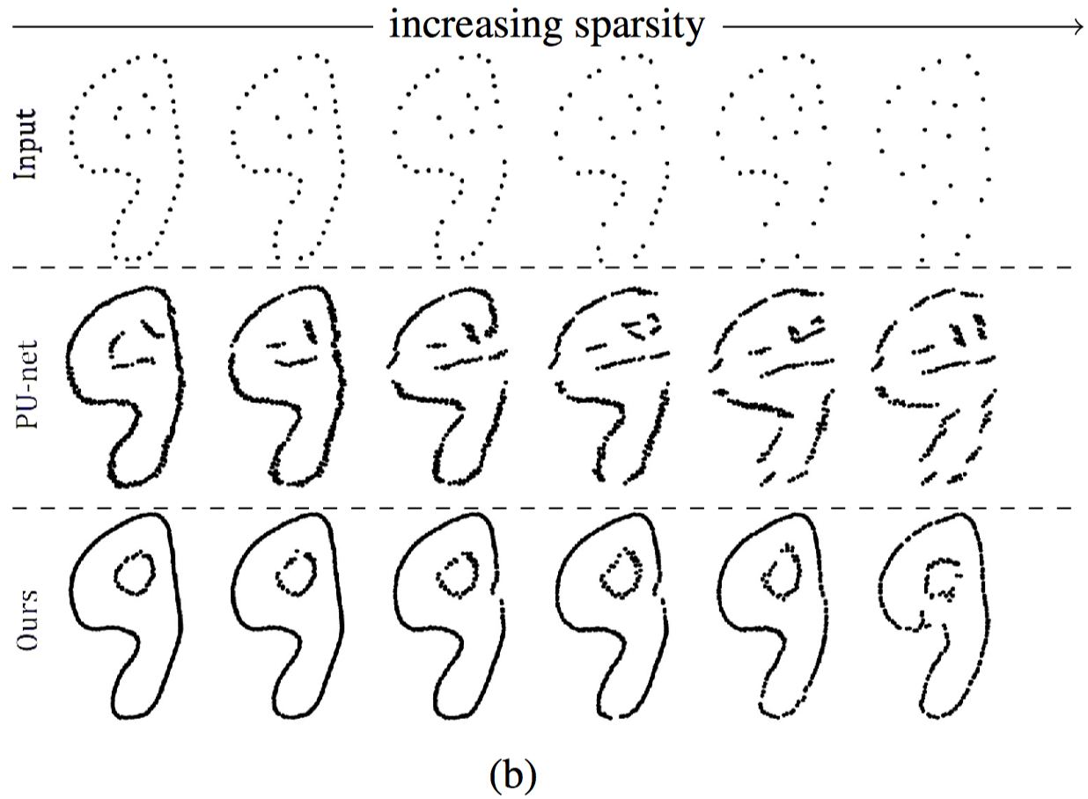
Robust under noise and sparse inputs

Slide 26
Limitations:
Training process is complex.
Requires more subnets for a higher upsampling rate.

Slide 27
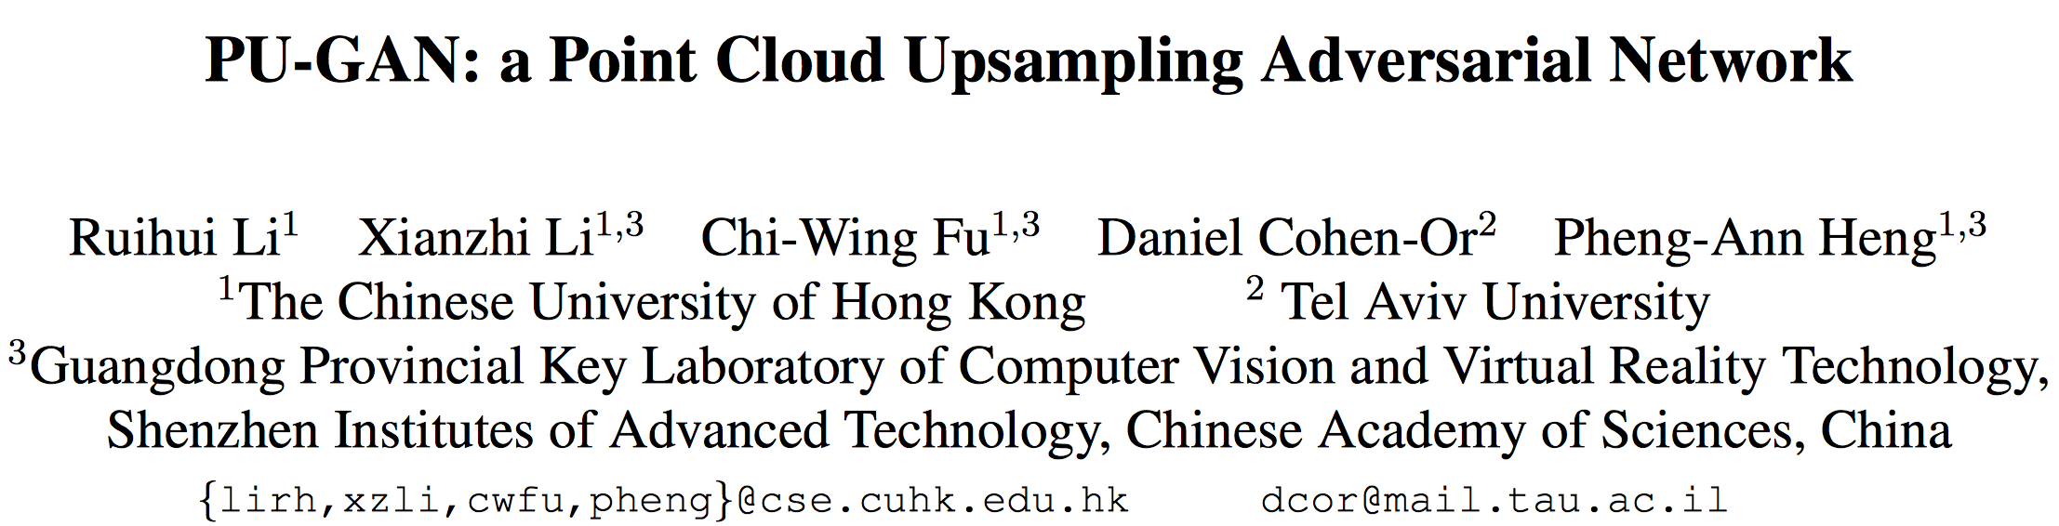

Slide 28
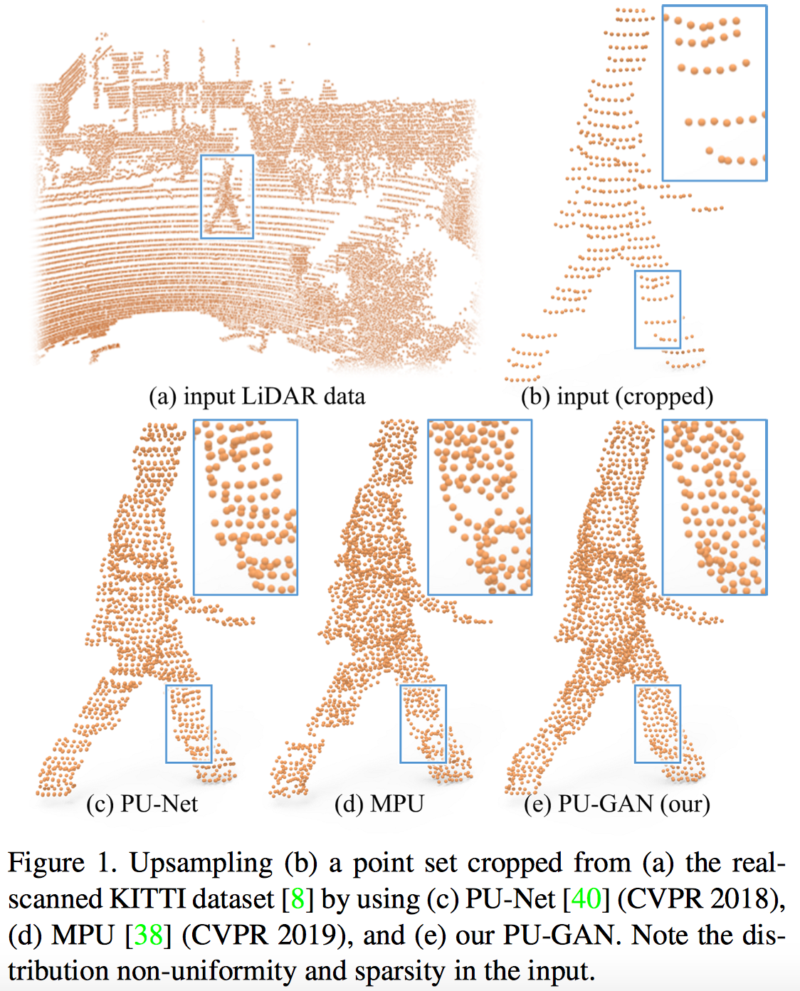
Sparse, noisy, non-uniform → dense, complete, uniform

Slide 29
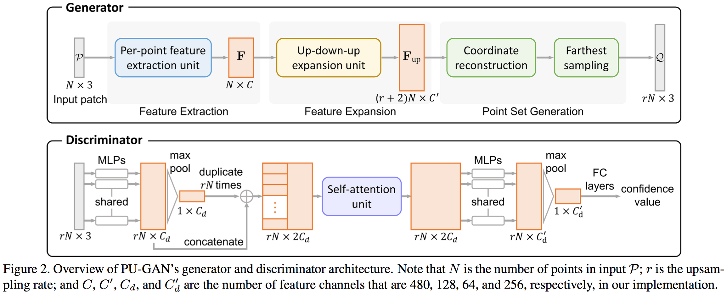
Notes:
Q可以不是P的super class，但Q需要满足(1)描述P的latent object surface。(2)分布均匀。

Slide 30
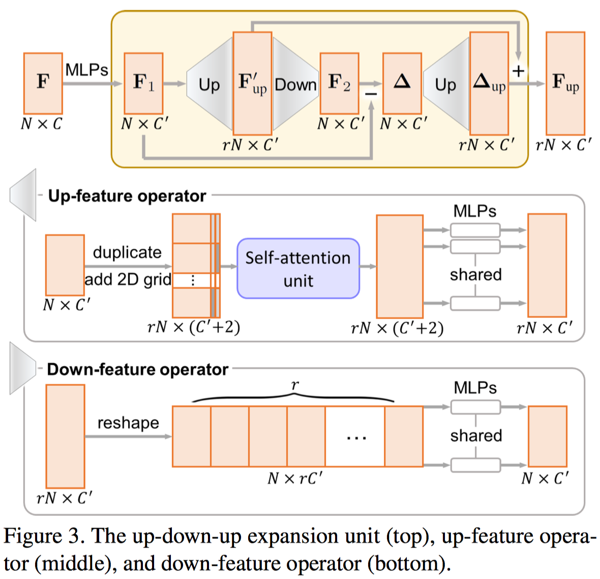

Slide 31
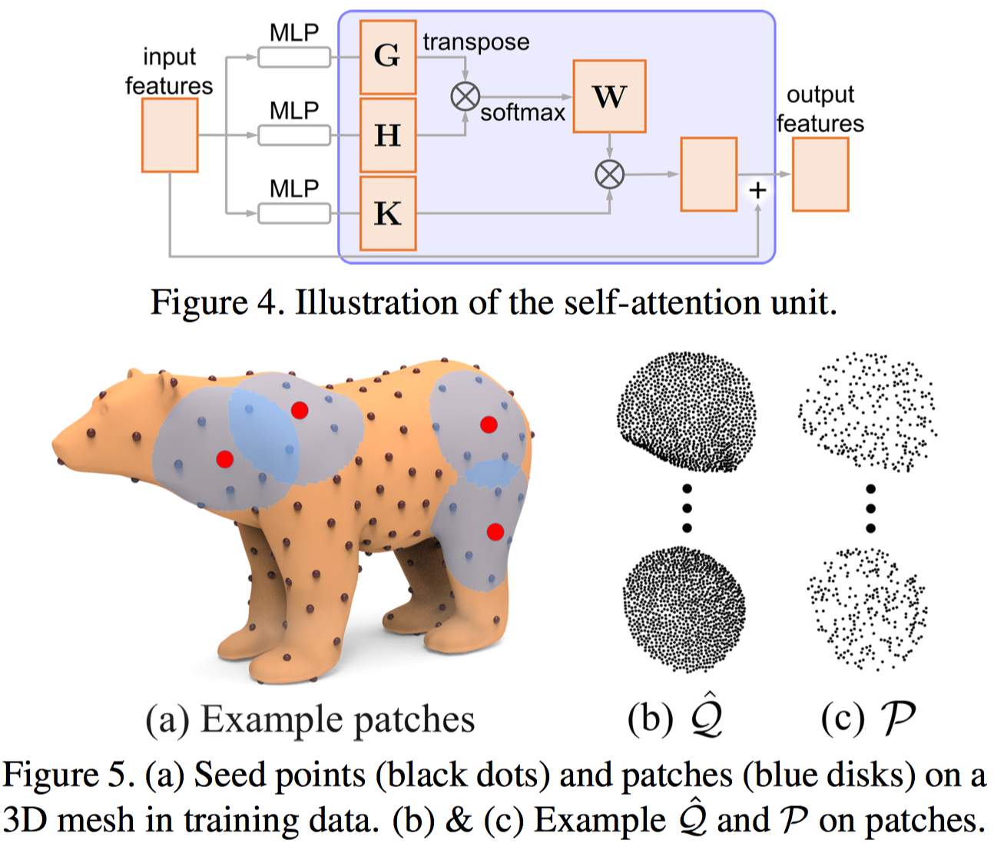
Target point set (rN points)
Input point set (N points)

Slide 32
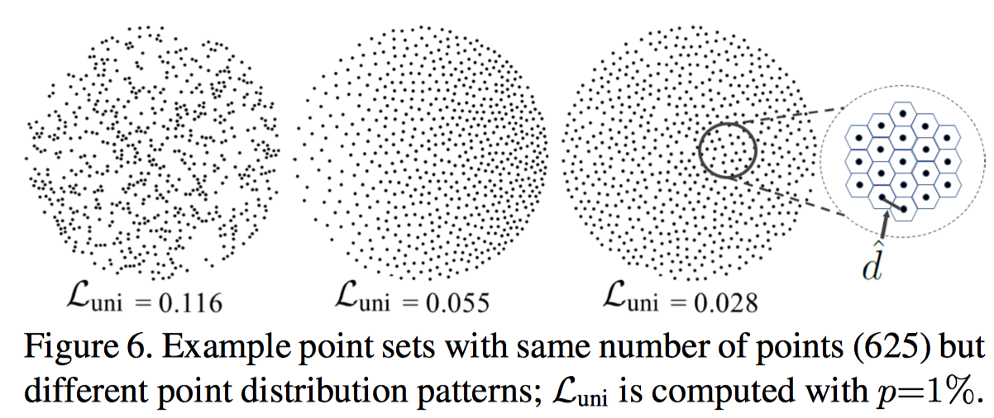
Uniform loss
Nonlocal uniformity
Local uniformity

Slide 33
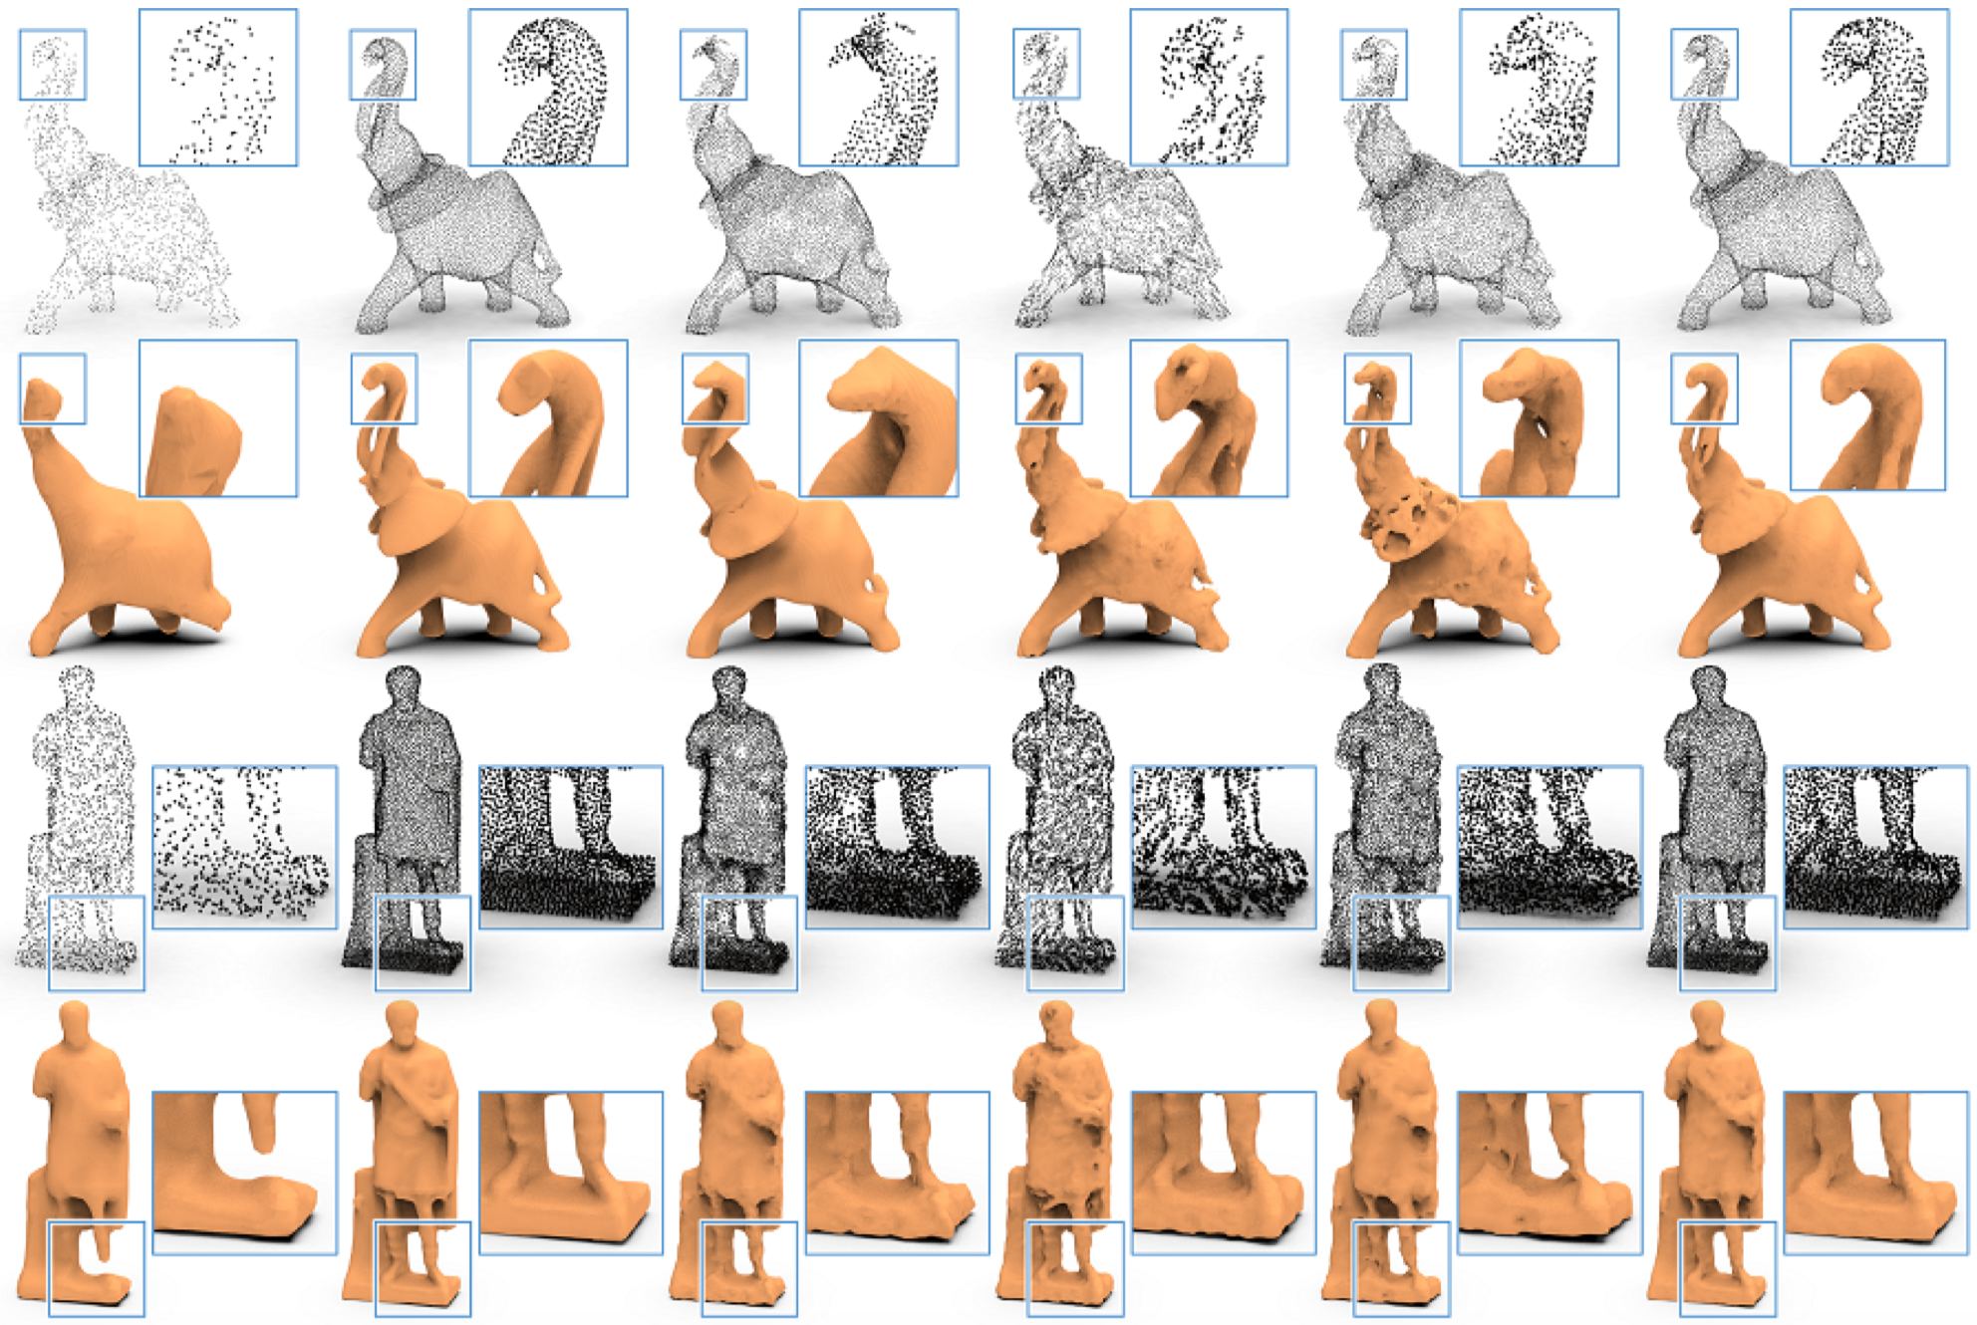

Slide 34
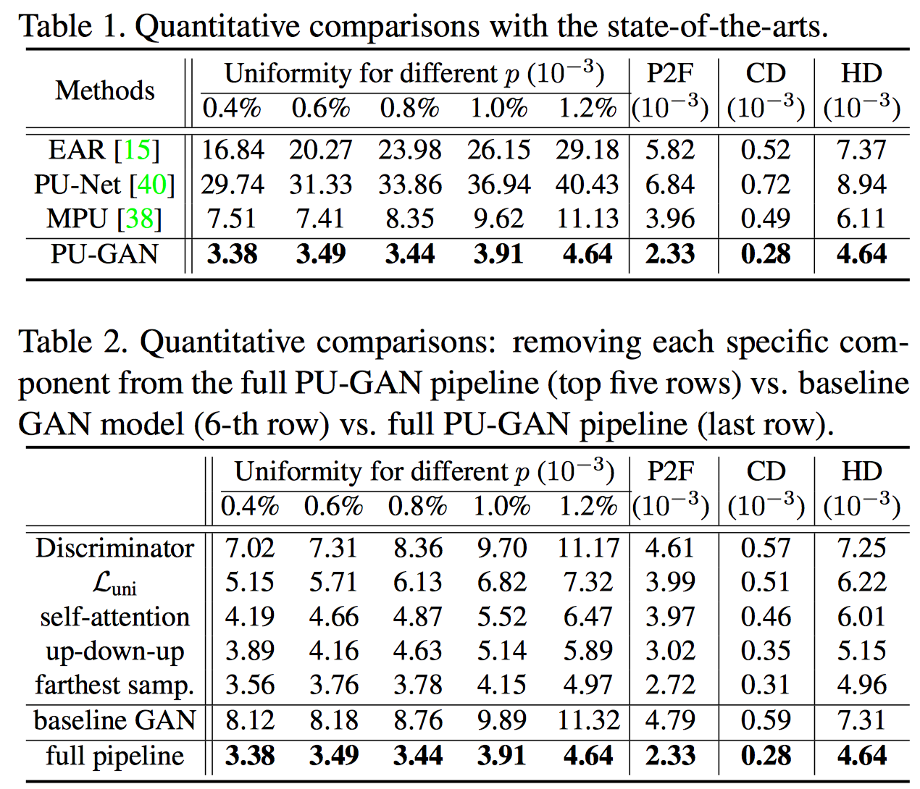

Slide 35
Limitations:
Since PU-GAN is designed to complete tiny holes at patch level, it has limited ability in filling large gaps or holes in point clouds.
Analyzing and synthesizing at the patch level lacks a global view of the overall shape.
Future work:
Explore a multi-scale training strategy to encourage the network to learn from both local small patched and global structures.
Explore conditional GANs, to let the network learn the uniformity and semantic consistency at the same time.

Slide 36
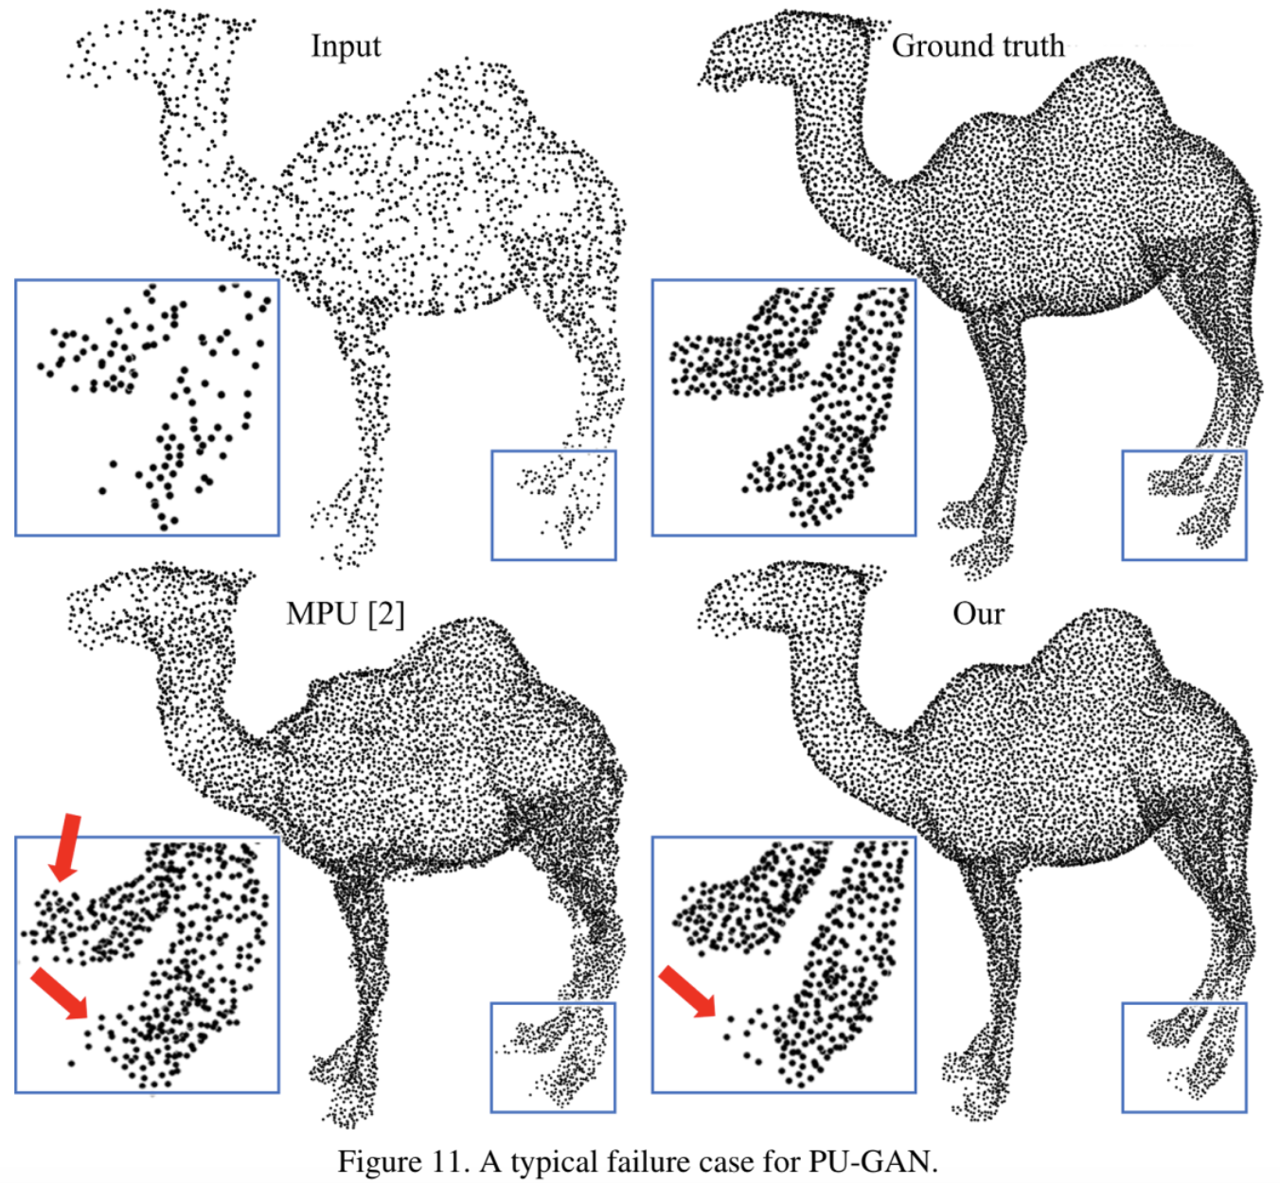

Slide 37
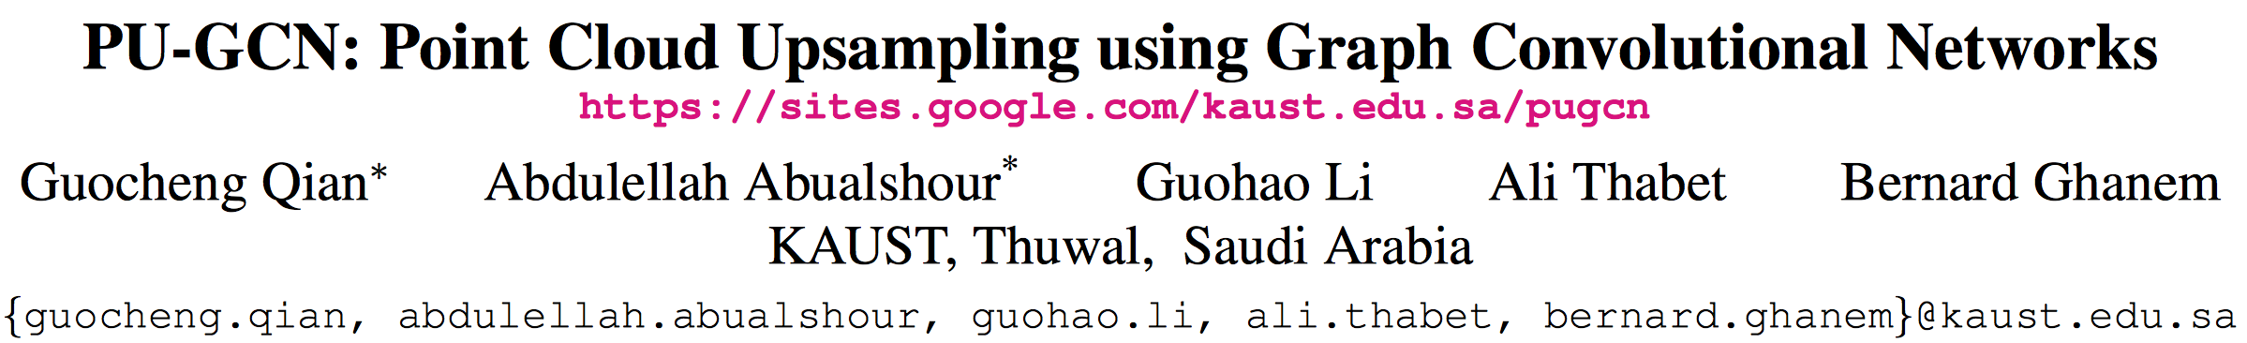

Slide 38
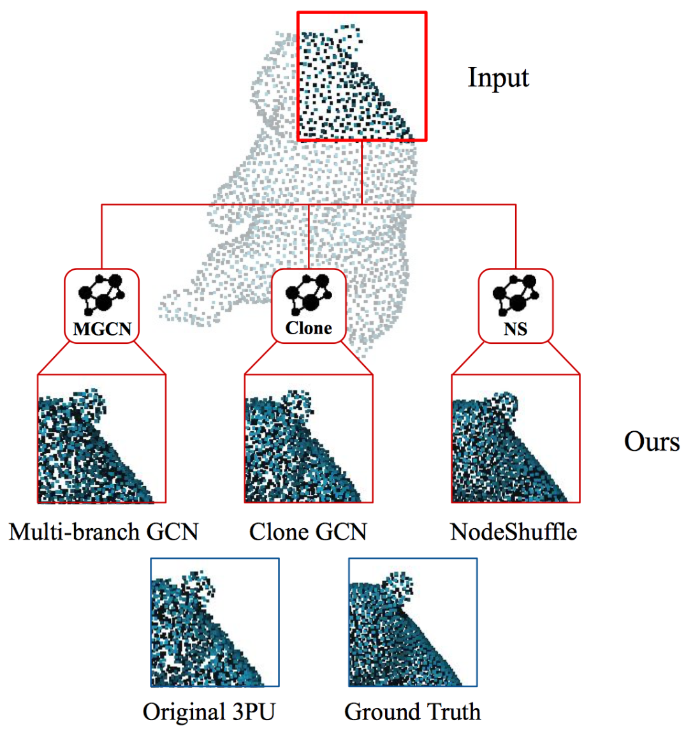

Slide 39
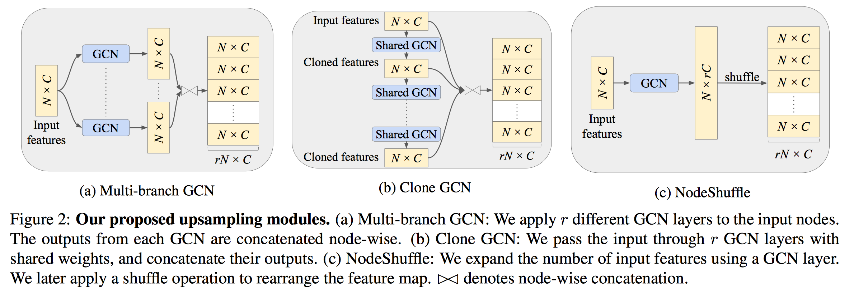

Slide 40
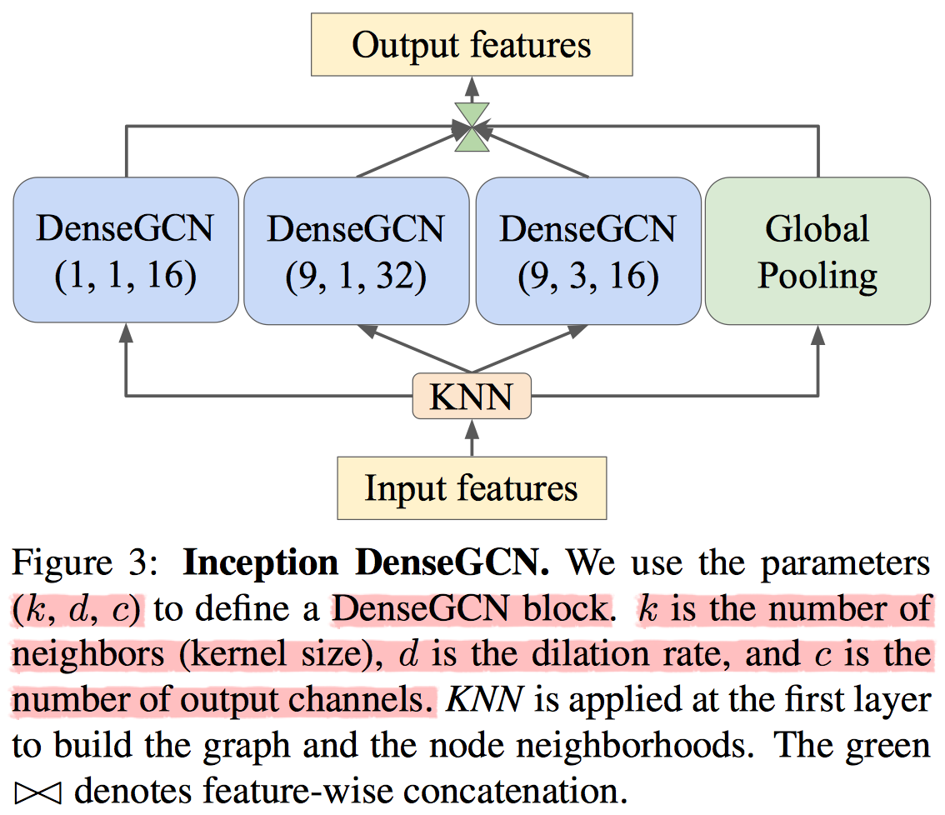
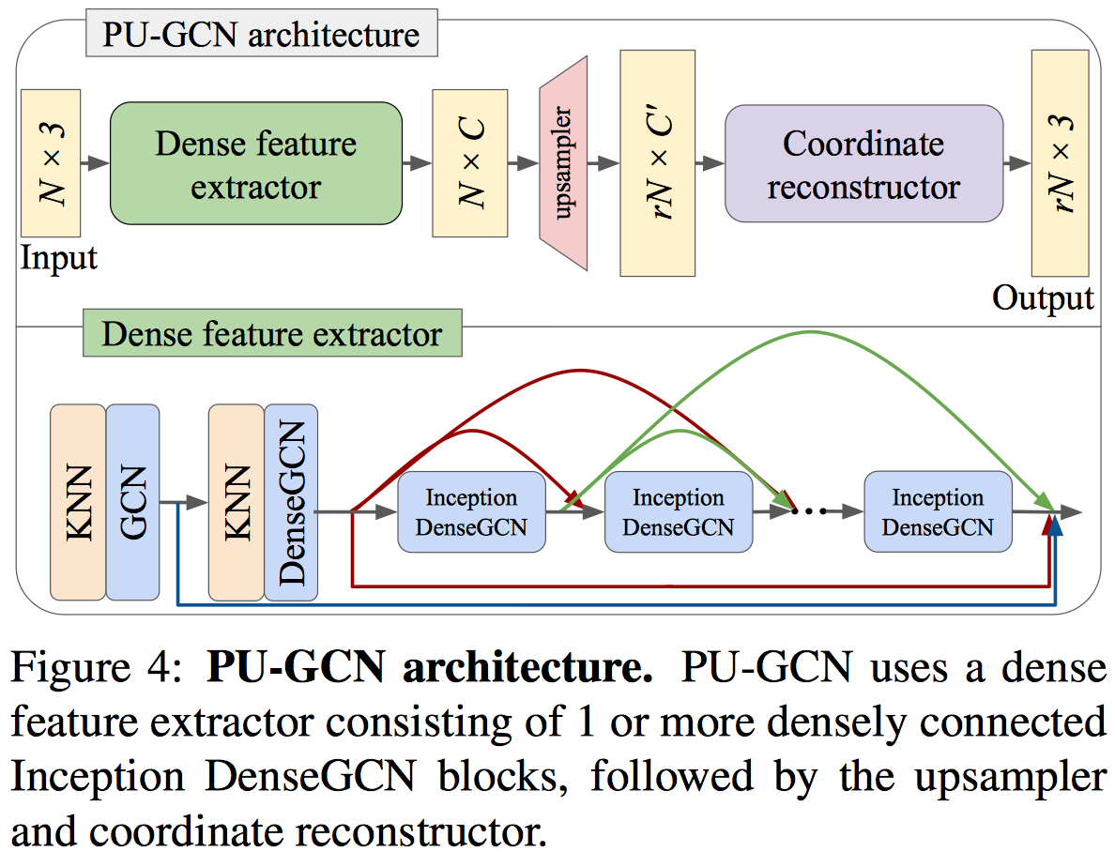

Slide 41
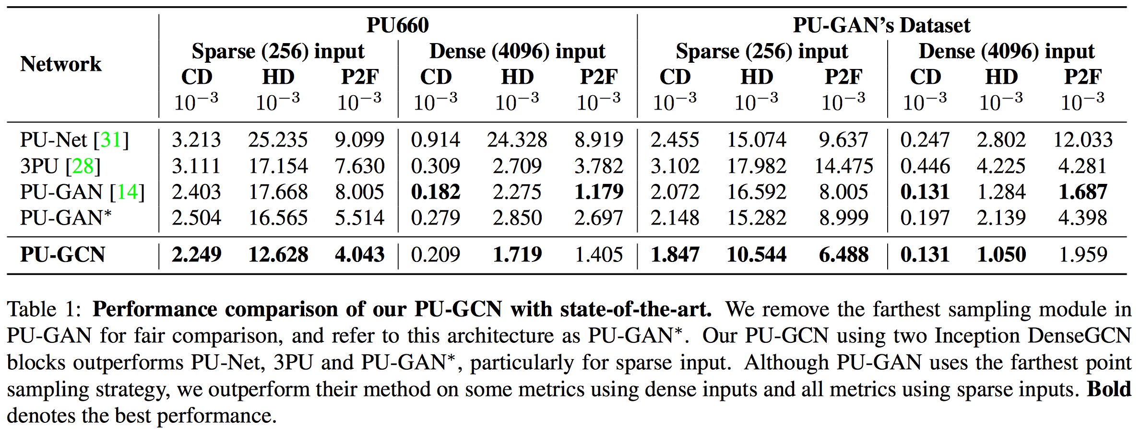

Slide 42
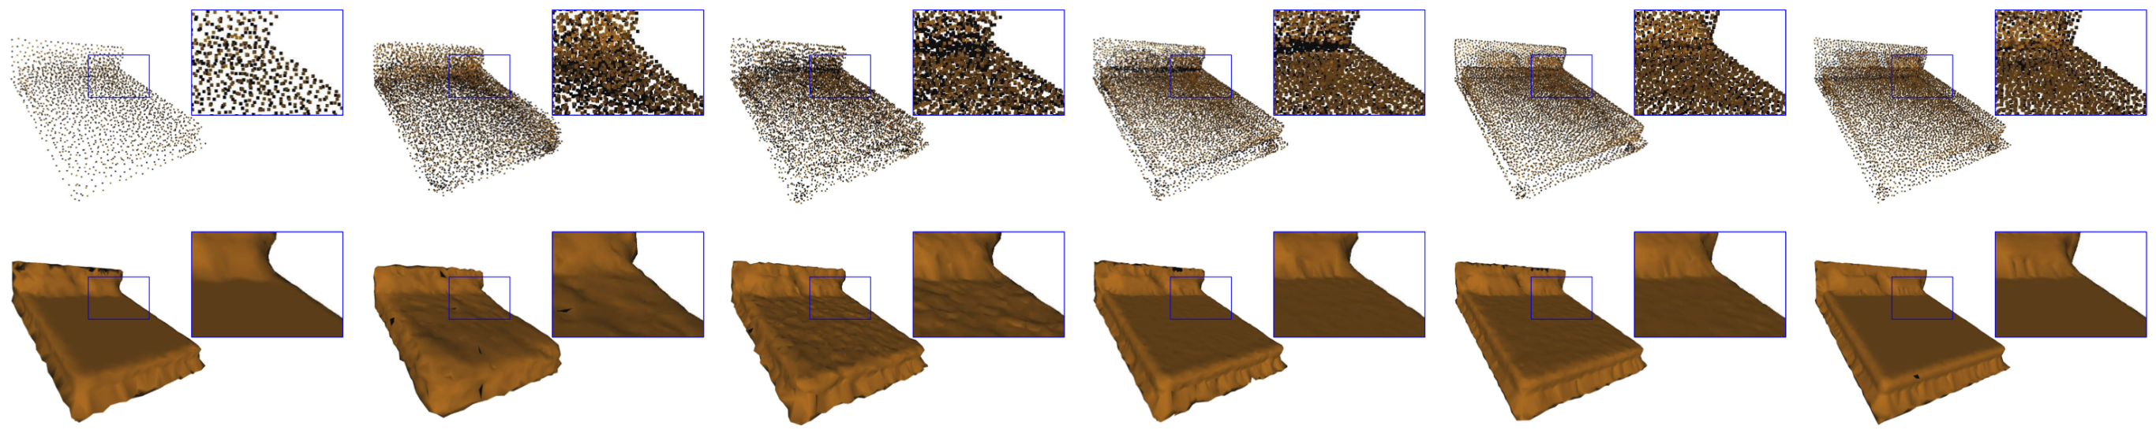
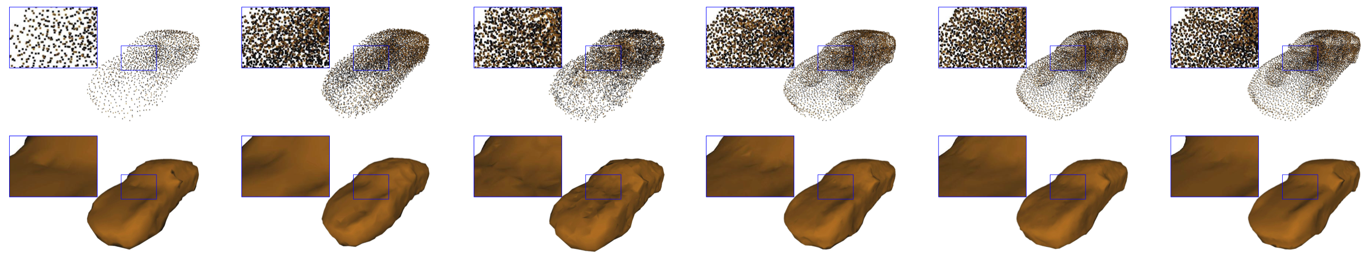
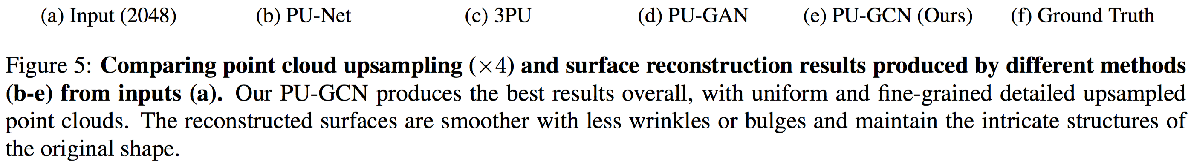

Slide 43
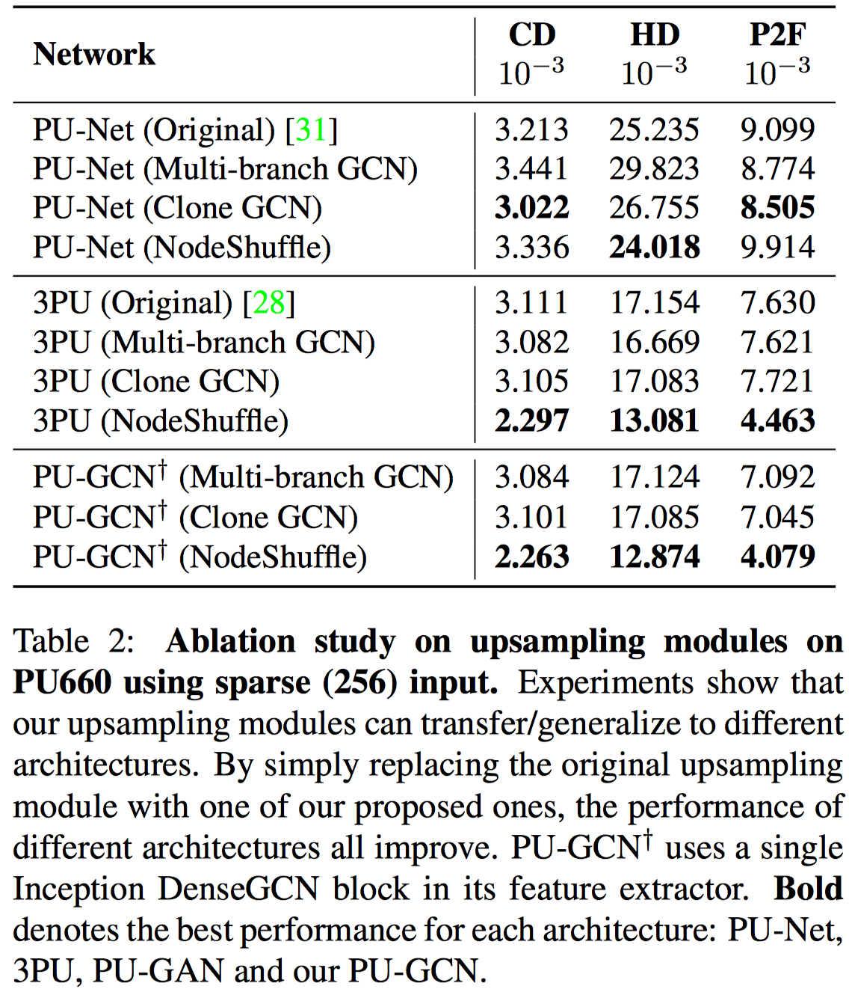

Slide 44
Thanks!

